Slide 1
Determining Political Parity With Twitter
Steve DeVito, Ben Harwood, Chris Webster

Slide 2
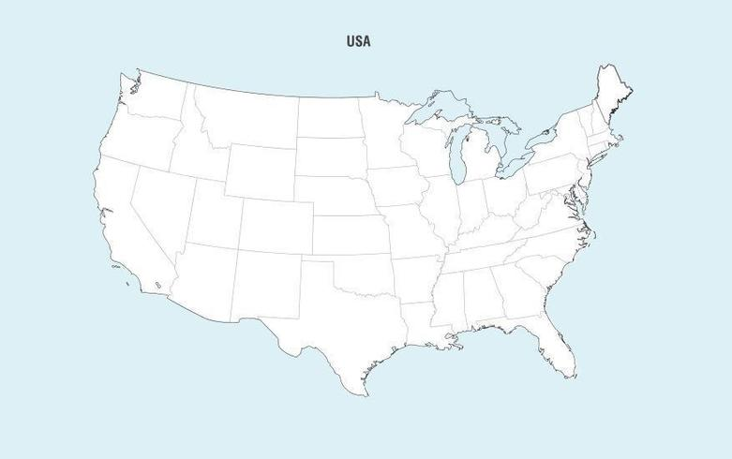

Slide 3
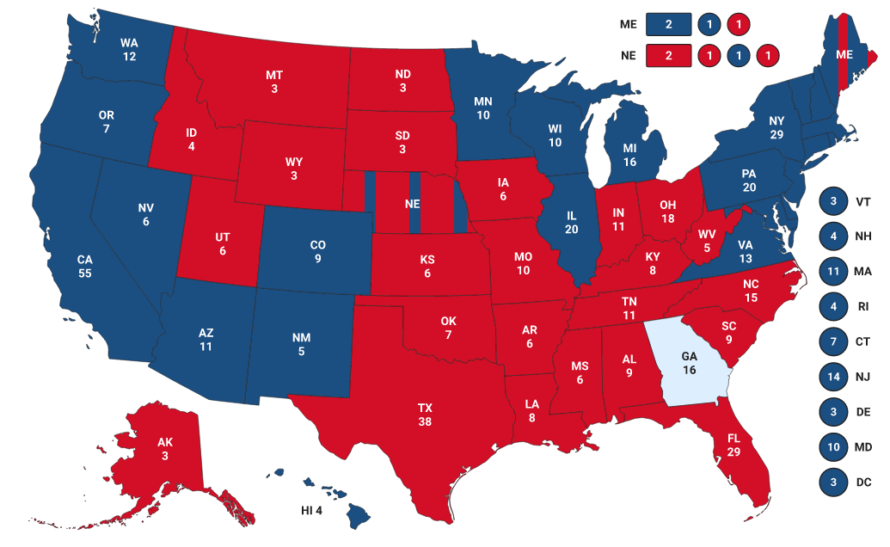
Image credit: FoxNews.com
Image credit: FoxNews.com

Slide 4




The Big Idea
Agenda

Slide 5

The Big Idea
Agenda

Slide 6

Data
Agenda
The Big Idea

Slide 7
Methods
Agenda
Data
The Big Idea

Slide 8
Methods
Agenda
Data

Slide 9
Agenda
Methods
Data

Slide 10
Results
Agenda
Methods
Data

Slide 11
Agenda
Results
Methods

Slide 12
Questions
Agenda
Results

Slide 13
Agenda
Questions
Results

Slide 14
Agenda

Slide 15
The Big Idea

Slide 16
The Big Idea
Guess
That
Tweeter!!!!

Slide 17
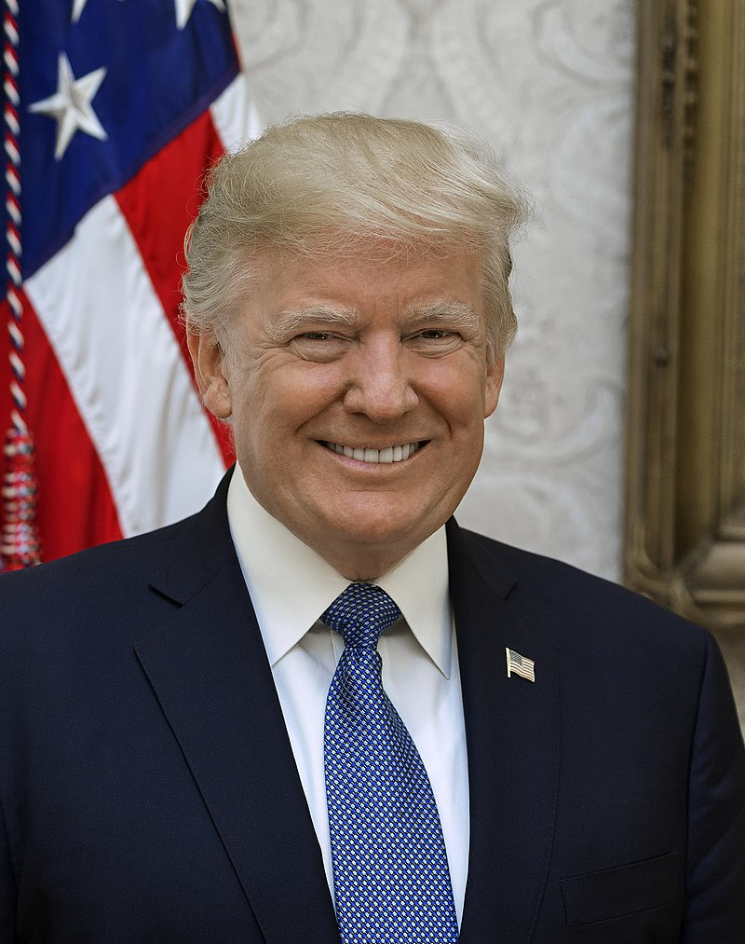
Data
The Big Idea
1
“There is tremendous evidence of wide spread voter fraud in that there is irrefutable proof that our Republican poll watchers and observers were not allowed to be present in poll counting rooms. Michigan, Pennsylvania, Georgia, and others. Unconstitutional!!!”
Donald Trump
Image credit: Official White House Portrait

Slide 18
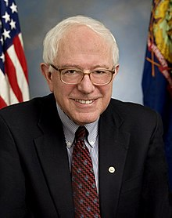
Data
The Big Idea
3
2
1
“The pandemic is surging and tens of millions of Americans are facing economic devastation. The Senate needs to pass a real stimulus package NOW that provides a month to the working class, a week to the unemployed, and expands Medicare to all.”
Bernie Sanders
Image credit: Official Senate Photo from 2007, sourced from Wikipedia

Slide 19
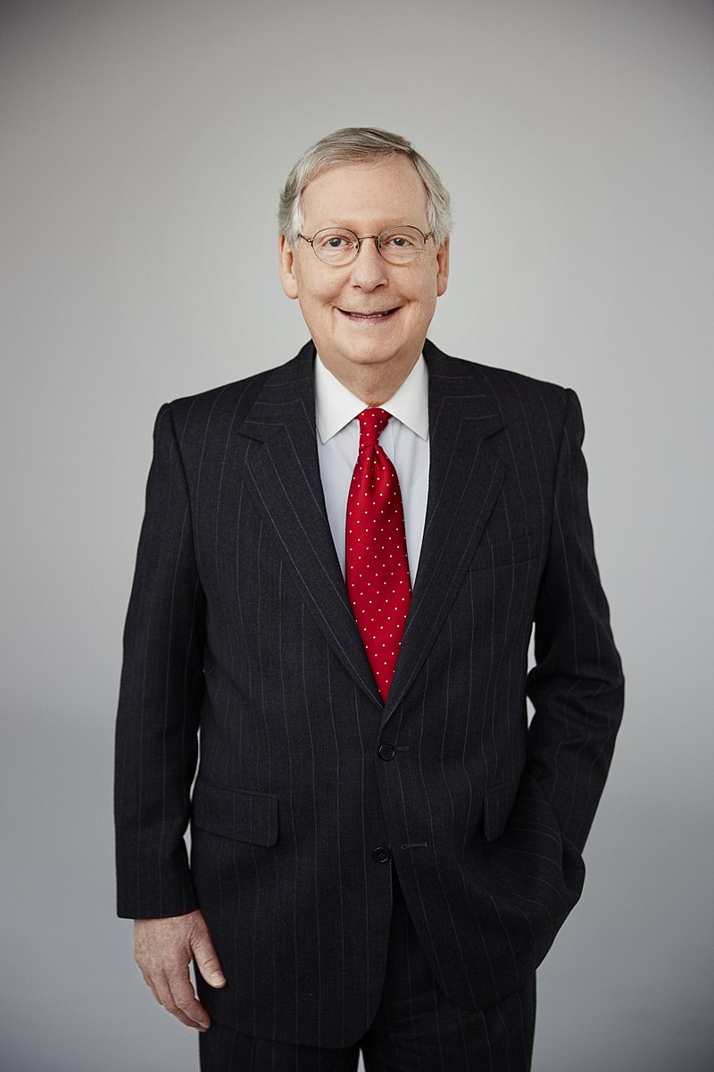
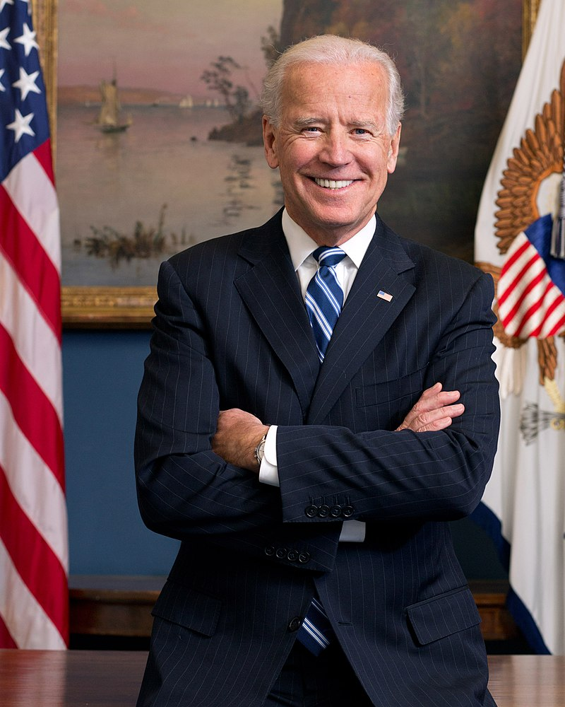
Data
Mitch McConnel
The Big Idea
3
2
1
“The Georgia Senate races are indescribably important. The entire country hinges upon the outcome of these runoffs.”
Joe Biden
Image credit: Official Portrait, 2013, sourced from Wikipedia

Slide 20
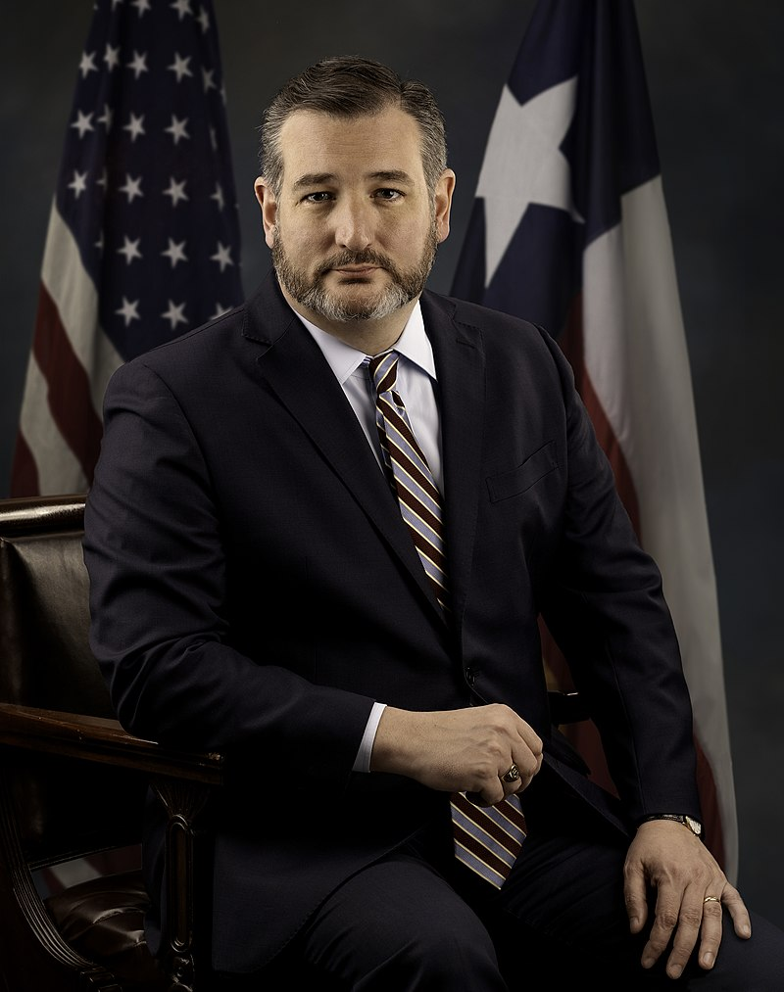
Data
The Big Idea
“The Georgia Senate races are indescribably important. The entire country hinges upon the outcome of these runoffs.”
Mitch McConnell
Joe Biden
Image credit: Official Senate Photo, sourced from Wikipedia

Slide 21
Data
The Big Idea
“The Georgia Senate races are indescribably important. The entire country hinges upon the outcome of these runoffs.”
Ted Cruz
Image credit: Official Senate Portrait, 2013, sourced from Wikipedia
Mitch McConnel

Slide 22
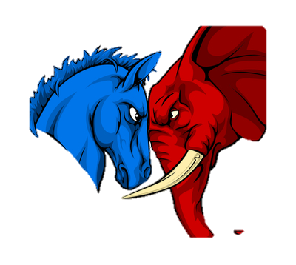
Data
The Big Idea
Tweet

Slide 23
Data
Tweets!!
Democrat
Republican
@SenWarren
@housegop
@AOC
@barackobama
@GOP
@SpeakerPelosi
@tedcruz
@foxnews
@berniesanders
@TuckerCarlson
@MittRomney
@housedemocrats
@maddow
@donlemon
@KellyAnnePolls
@seanhannity
@msnbc
@lindseygrahamsc

Slide 24
Tweets!!
Data
Users per party: 9
Democrat
Republican
@SenWarren
@GOP
@housegop
@AOC
@MittRomney
@barackobama
Tweets per user: 250
@SpeakerPelosi
@TuckerCarlson
@cnn
@berniesanders
@foxnews
Total Tweets: 4,500
@seanhannity
@donlemon
@maddow
@tedcruz
@KellyAnnePolls
Unique tokens: 11,389
(minus stop words)
@lindseygrahamsc
@msnbc

Slide 25
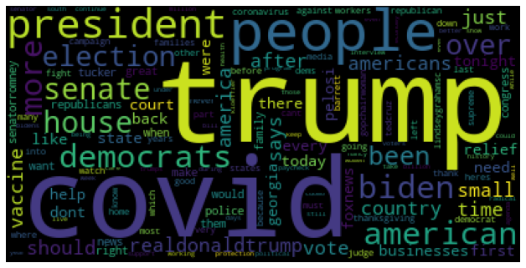
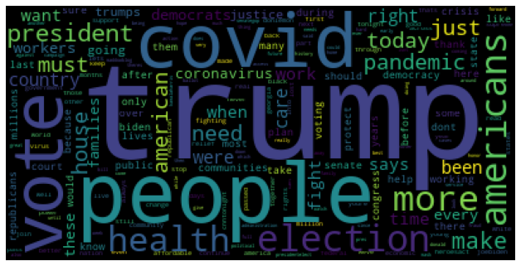
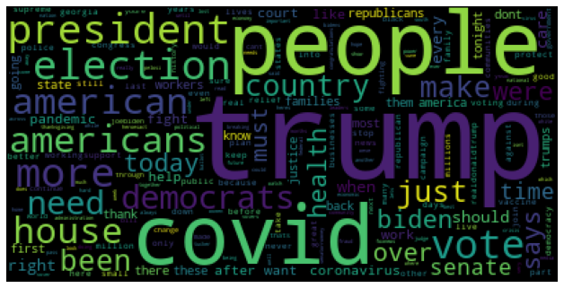
Users per party: 9
Data
Republicans
Democrats
Total Tweets: 4,500
Unique tokens: 11,389
(minus stop words)
Combined
Tweets per user: 250

Slide 26
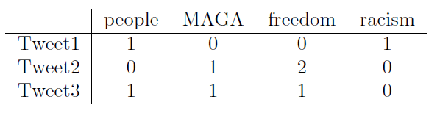
Data
Maga
freedom
people
Words
racism
Vectorize
Frequency, Bernoulli, TFIDF

Slide 27
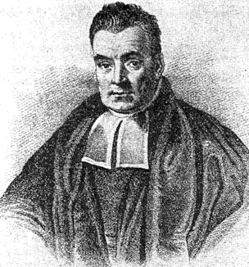


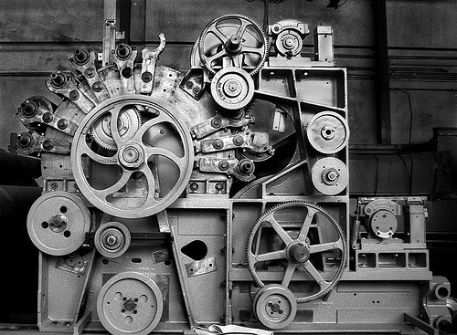
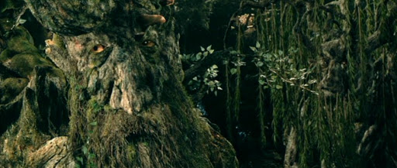
Methods
Data
Hmm…

Slide 28
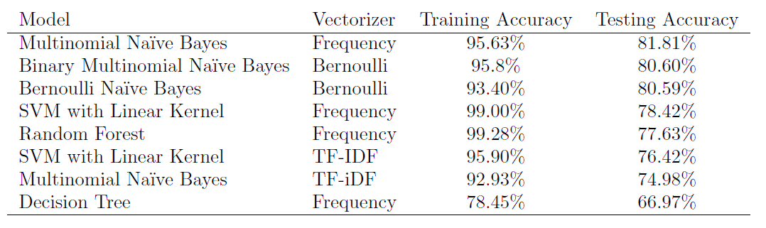
Methods
Data
(Part Deux)

Slide 29
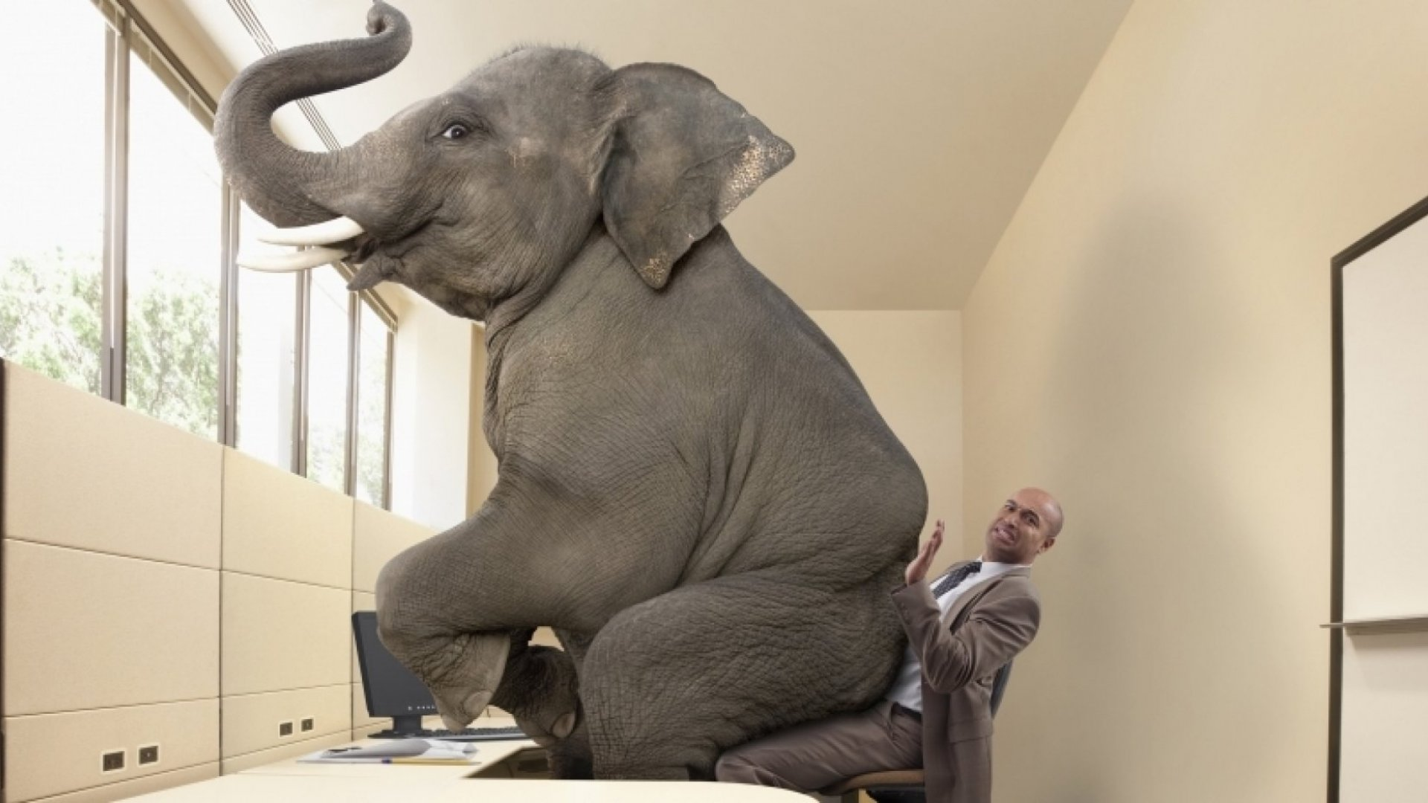
Methods
Data
(Part Deux)

Slide 30
Methods
Data
(Part Deux)
#

Slide 31
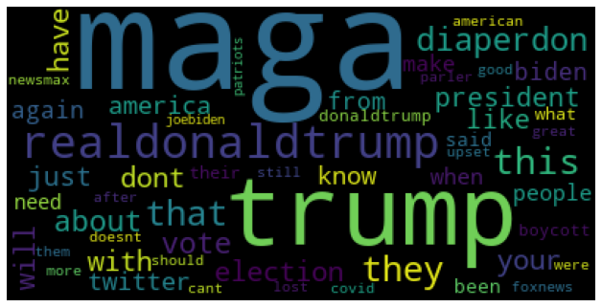
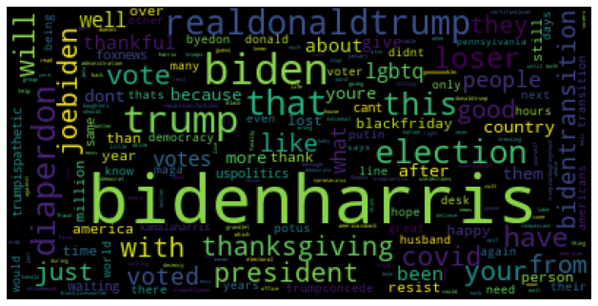
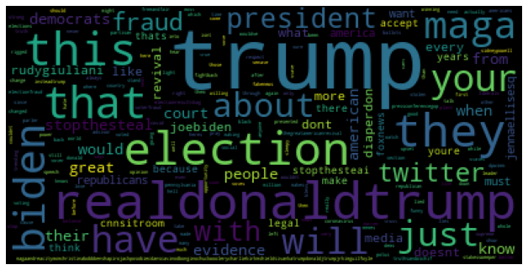
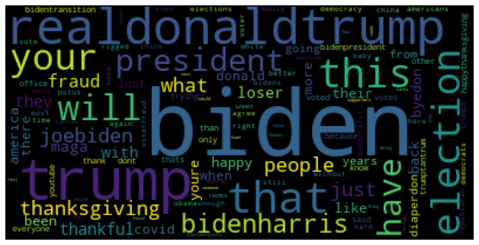
Data
(Part Deux)
#maga
Popular hashtags
#bidenharris
#trump2020
#biden2020
1000 tweets total

Slide 32

Lots of text incoming. You’ve been warned…
Results

Slide 33

Results
Lots of text incoming. You’ve been warned…

Slide 34
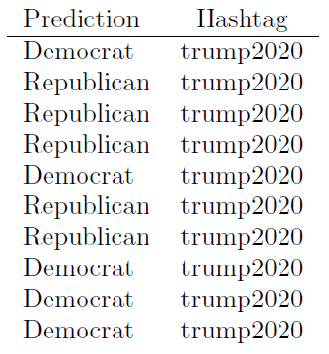
Results
Tweets predicted Republican: 561
Tweets predicted Democrat: 439
Total Number of biden2020 that are labeled as Republican: 146
Total Number of biden2020 that are labeled as Democrat: 104
Total Number of bidenharris that are labeled as Republican: 77
Total Number of bidenharris that are labeled as Democrat: 173
Total Number of maga that are labeled as Republican: 194
Total Number of maga that are labeled as Democrat: 56
Total Number of trump2020 that are labeled as Republican: 144
Total Number of trump2020 that are labeled as Democrat: 106

Slide 35
Results
Trump lied to MAGA and the American people Demand a CovidCommission Coronoavirus updates Every hour Americans are dying AstraZeneca plans additional trial after error hospitalizations hit record again via usatoday

Slide 36
Ideas for the future:
Results
Could this or similar techniques have prevented the abject failure of pollsters leading up to the 2016 and 2020 elections???

Slide 37
Ideas for the future:
Geography
Bigram and trigram analysis
Even more tweets, both users and hashtags
Historical
Incorporate independents
Regional

Slide 38
Questions?

Slide 39
Questions?

Slide 40
References

Slide 41
Thank you

